Slide 1
Critical Pathway Analysis:
A part of Evaluation and Demonstration of New Tuberculosis Diagnostics for Indonesia
(EVIDENT Indonesia)

Slide 2
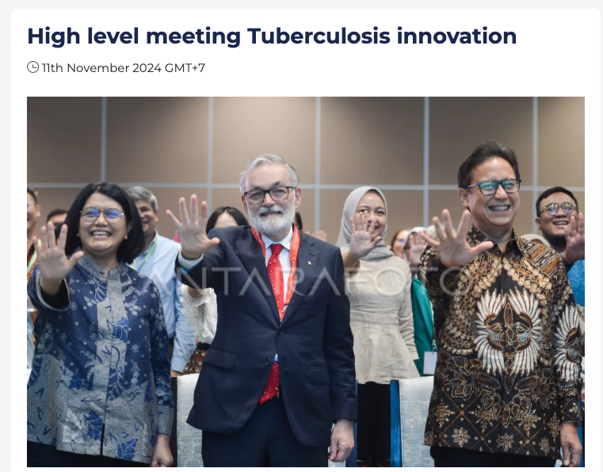
Context
There has been a commitment by the Government of Indonesia to open up for innovative TB diagnostics to be used in Indonesia (Nov 2024).
From January to May 2025, the Ministry of Health has been revising a standard related to the pre-market clinical validation of medical devices for obtaining regulatory approval for Tuberculosis (Co-creation 1).
In the same time, MoH also develop a framework for simplified Health Technology Assessment (sandbox) procedure for general digital and treatment technology (not only for Tuberculosis) (Co-creation 2).

Slide 3
Data collection
Qualitative data (up to July 2025) :
Document reviews: regulations, meeting notes with MoH and other stakeholders
Interviews: 8 vendors, 2 MoH units, one provincial health office, and one association of distributor representatives.
Participatory in 13 co-creation meetings with MoH and other stakeholders
More co-creation meetings are planned

Slide 4
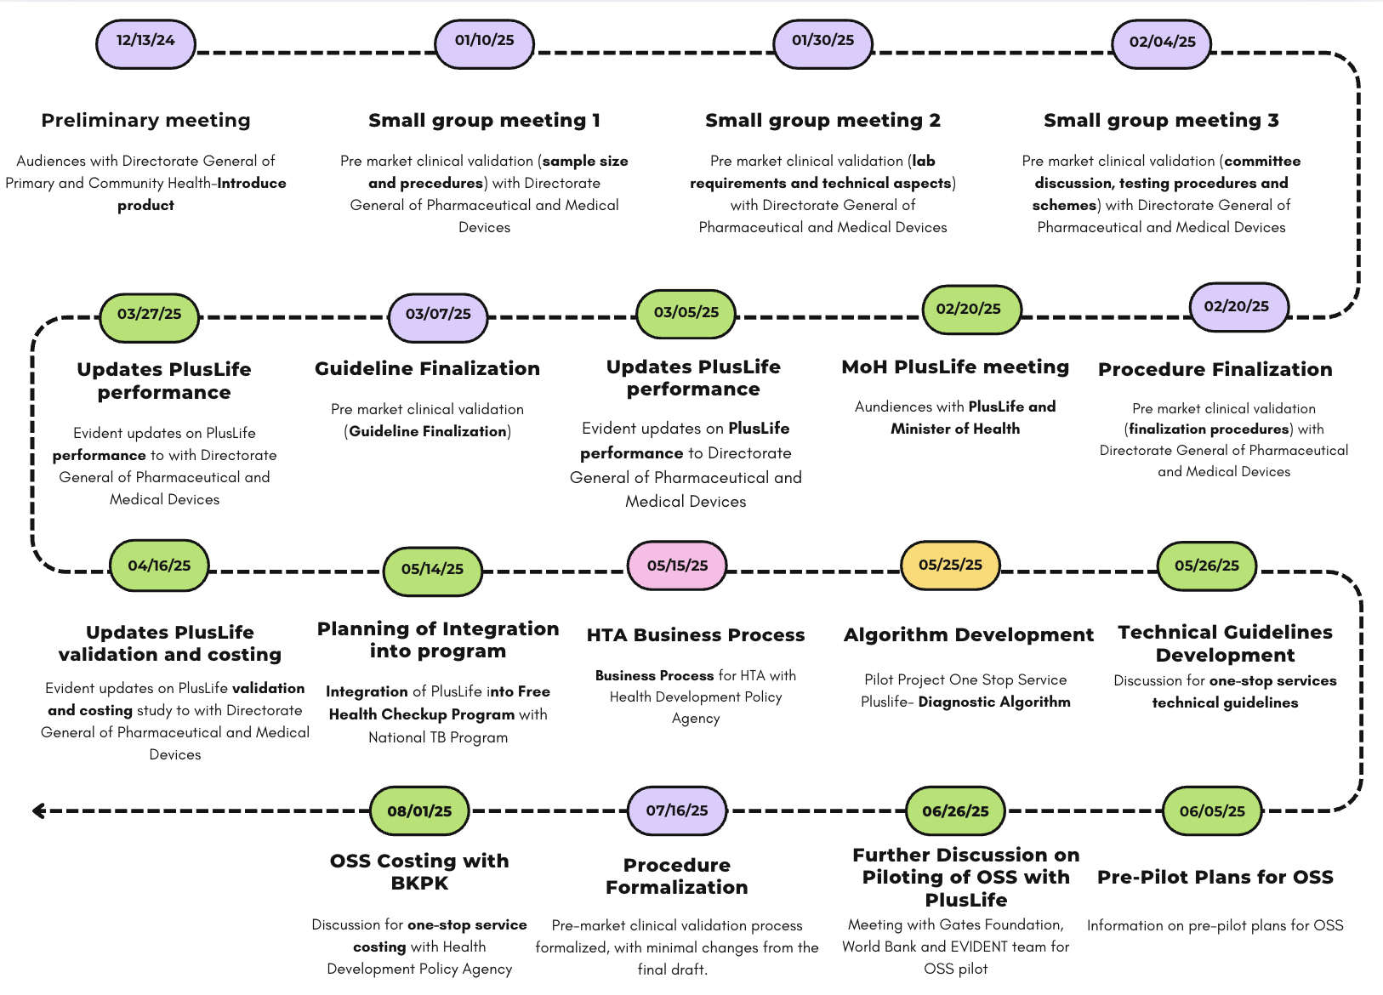
Pathway Co-creation Timeline
*Business process meeting on 05/15/25 applies for general HTA, not specific to TB.
Notes:
Notes: Co-creation 2 started in 15th of May 2025

Slide 5


Pathway before Nov 2024
(finalized 16 Dec 2024)
Adoption by private sector
WHO recommendation
.
2-3 months
Regulatory approval by Directorate General of Pharmaceuticals and Medical Devices
Health Technology Assessment
New TB diagnostics
Adoption by NTP
Procurement
Funding scheme
Operational research
by MoH
by DHO & public hospitals
Audiences with MoH
Inclusion in national/international guidelines
Political will
Feasibility & ease of use
Urgency of use
Negotiation skill
Recommendation from academics

Slide 6
Co-creation: Pathway for Tuberculosis Diagnostics
(preliminary finding up to July 2025)
Adoption by NTP
Health Technology Assessment (HTA) sandbox***
Consideration?**
New TB diagnostics
Pre-market Clinical Validation*
NIE (Regulatory Approval)
Operational Research/Pilot study
Economic evaluation
Market
*) The guideline of pre-market clinical validation is being finalized (July 2025). Consideration of fast track adoption without HTA is now being discussed, and can be the urgency of new diagnostic test for TB
**) Perceived urgency by the MoH
***) The HTA Sandbox is still general, and HTA for diagnostic tests has not been incorporated in the “new framework” of HTA (sandbox)
Notes:
HTA sandbox is general, not focusing on TB, or diagnostic. But focusing on treatment and digital innovation. However, based on initial discussion, TB diagnostic will follow this guideline
Operational research → hyperlink ke OSS

Slide 7

Mechanism for Validation Testing of Diagnostic Tools and Reagents for TB Testing (July 2025)
Manufacturers
Conducts validation testing at designated laboratories
A
B
Testing at 2 (Two) Different Laboratories
Laboratory A tests the reagen kit with a different lot number than Laboratory B
Test Results
Meets Requirements
Discordant
Does Not Meet Requirement
Retested at a Different Laboratory
Reviewed by Expert Team
Registrant Conducts Evaluation and Product Improvement
Proceed with Licensing Application Process
Reviewed by Expert Team
Yes
Meet Requirements
No

Slide 8
Co-creation 1: Stakeholder Identification
Pre-market Clinical Validation | Health Technology Assessment | Adoption | Procurement | Roll-out and Scale-up
Directorate General of Pharmaceutical and Medical Devices TB Expert Committee TB Working Group Lab | Health Development Policy Agency TB Expert Committee TB Working Group Lab | Directorate General of Community and Primary Healthcare National TB Program | Directorate General of Pharmaceutical and Medical Devices National TB Program Secretary General of MoH District Health Office | Directorate General of Pharmaceutical and Medical Devices National TB Program Directorate General of Community and Primary Healthcare District Health Office

Slide 9
Example of co-creation 1: Pre-Market Clinical Validation Process
Before 2025 | 2025 - onward
Imported products go through a document-based validation, whereas indigenous products go through a lab-based validation. Process on average 3-6 months. Unclear lab standards for validations, perceived difficulty by local manufacturers. | Both imported and indigenous products will go through a lab-based validation process. The process will take at most 4 months. Clear regulations on lab standards for validation. Labs must: 1) have access to clinical specimens, 2) capability for culture (gold standard), sensitivity, and molecular testing, 3) be accredited with SNI ISO/IEC 17025 and SNI ISO 15189. Approx. 200-400 samples are needed with an absolute deviation of 7% (variation due to prevalence). Criteria for sputum sample storage: 1) room temperature (3 days), 2) 2-8 Celsius (7 days), 3) -80 Celsius (1-2 years). Validation will be conducted by two accredited labs, with a third one for ambiguous results.

Slide 10
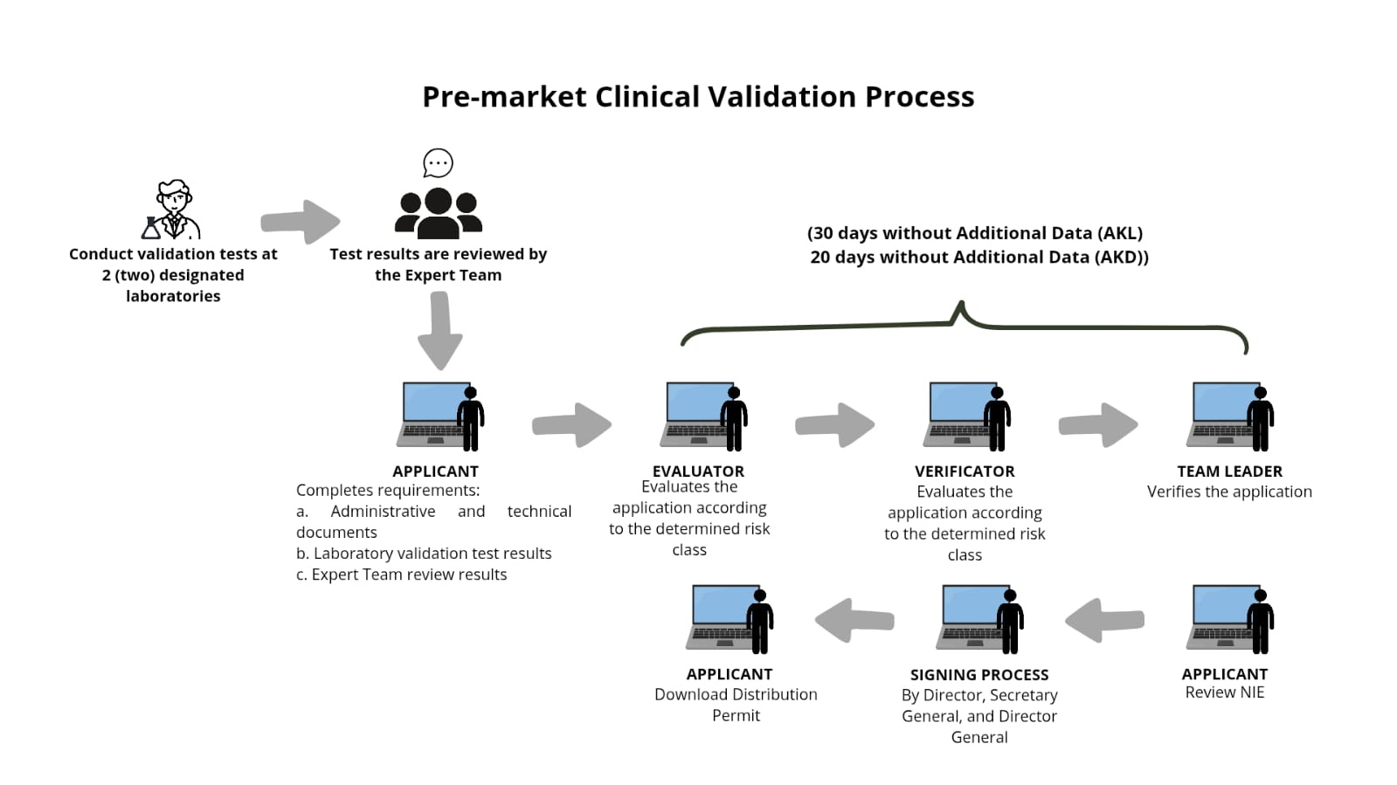
Example of Co-creation 1:
Pre-market Clinical Validation Process for TB diagnostics
Source : Ministry of Health Indonesia
Notes:
Translate.

Slide 11
Co-creation 2: Recent Developments of HTA
As of 04/06/25, the HTA process is yet to be finalized and significant changes are still taking place.
As of 14/05/25, the stakeholder-led submission scheme is being piloted.
Several important developments include a clear criteria selection for priority topics, sandboxing as a proposed business plan for HTA, and a clear framework for evaluation.
Discussion and co-creation is still ongoing, with several members of the EVIDENT team as authors.

Slide 12
Co-creation 2: Stakeholder Identification for HTA Process
Stakeholder | Topic Proposal | Verification of Topic Proposal | Priority Topic Selection | Data and/or HTA Provider | Assessment | Appraisal | Policy Recommendation | Implementer | Monitoring
Health Technology Assessment Committee | √ |  | √ | √ | √ | √ | √
Ministry of Health | √ | √ |  | √ | √ |  | √ | √ | √
BPJS (National Health Insurance) | √ |  |  | √ |  |  |  | √
Professional Organization/Expert Panel (TB Expert Committee, TB Working Group, etc) | √ |  |  | √ | √ | √ |  | √
Other Expert Panel (health economics, sociocultural, public health, etc) | √ |  |  | √ | √ | √
Hospitals | √ |  |  | √ | √ |  |  | √
Universities | √ |  |  | √ | √
Patient and/or Patient Organizations | √ |  |  | √ | √ | √
Pharmaceutical and Health Technology Industry | √ |  |  | √ | √ |  |  | √ | √
*last updated on May 2025

Slide 13
Co-creation 2: Health Technology Assessment (HTA) for general health technology
Regular topic submission
Pre-submission consultation
HTA secretariat, proposer
Priority topic verification & selection
Secretariat, HTA committee
Stakeholder-led submission (SLS)
Pricing offer
Review
HTA agents, expert panel
Value-based pricing & price negotiation
HTA agents, expert panel
Assessment
HTA agents, expert panel
Appraisal
HTA committee, expert panel
Drafting recommendation
HTA committee
Policy decision
Ministry of Health
* Based on MoH Regulation, for general health technology, not only for TB
Notes:
Keputusan Menteri Kesehatan No. HK.01.07/MENKES/1572/2024 Tentang Komite Penilaian Teknologi Kesehatan
Penyusunan Draft Pedoman Teknis Mekanisme stakeholder-led-submission (SLS)
Keputusan Menteri Kesehatan no HK.01.07/MENKES/1573/2024 Tentang Uji Coba Stakeholder Led Submission Dalam Penilaian Teknologi Kesehatan
*Not yet available online

Slide 14
Co-creation 2: Regular vs Stakeholder-led Submission
Regular Submission | Stakeholder-led Submission
HTA assessments are conducted in-house by the Ministry of Health in collaboration with HTA Agents (Universities, Research Centers). | HTA assessments are conducted independently by HTA stakeholders, and the results are submitted to the Ministry of Health for review.
Proposers are not charged a fee; the technologies assessed through HTA are selected based on a topic prioritization mechanism. | Proposers are charged a fee to request a review of the HTA assessment results they have conducted.

Slide 15
Co-creation 2: HTA topic criteria selection
6 Priority Topic Criteria |  |  | Weight
1 | Impact of technology on health | (+) Efficacy & QoL (-) Harm, misuse risk | 26%
2 | Alignment with priority policies | Consistency of technology with policies/development program | 20%
3 | Cost-saving potential | Efficiency potential in national health insurance program expenditure | 13%
4 | Volume | Utilization Prevalence, Incidence | 14%
5 | Technology cost | Unit cost, cost per service, screening/test cost | 11%
6 | Acceptance | Acceptance according to community values/needs | 16%

Slide 16
Co-creation 2: Assessment Framework
MRC Framework (UK Medical Research Council) | RE-AIM Framework | AAAQ Framework | Cost-effectiveness
Implementability : Can the action be carried out? Mechanism of impact How does the technology lead to change? 3. Contextual Influence System and contextual factors that influence implementation Reference : MRC Guidance on Developing and Evaluating Complex Interventions | Reach : Who is intended to be affected by the technology ? Effectiveness : Does the technology achieve intended impact ? Adoption : Are relevant organizations able and willing to implement it | Availability : Is the technology available Accessibility : Can the technology be accessed without excessive burden? Acceptability : Is it well received by the public ? Quality : is it effective for its intended use | Cost-effectiveness analysis Cost-utility analysis Budget impact analysis

Slide 17
Co-creation 2: Sandbox for HTA Business Process
Proposed Innovation Assesment Business Process: Sandbox
Accept applications to enter the Sandbox
Conduct horizon scanning for emerging technologies (e.g., via hackathons)
Conduct TRL assessment
Issue temporary authorization for certain technologies to be tested in the Sandbox
Coordinate monitoring and evaluation of Sandbox results
Solution #2
Sandbox as an Innovation Process for Testing and Accelerating Health Technology
1. Accelerates the adoption of new technologies that do not yet have a complete regulatory framework
2. Reduces market entry barriers for local or frontier technologies
3. Encourages cross-sector collaboration among developers, regulators, service providers, and patients
4. Provides real-world evidence (RWE) to support evidence-based decision-making (e.g., Health Technology Assessment/HTA)
Solution #1
Implemented One Stop by one work unit in the Ministry of Health
Submission of Health Technology Proposal
Technology Profile Review
Solution #5
Formation of a Special Committee for the Evaluation of Innovative Technologies, with tasks:
Select and conduct early evaluation of technologies
Set evaluation criteria and protocols
Monitor and supervise implementation
Final evaluation and policy recommendations
Cross-sector coordination and collaboration
Capacity building and governance development
Innovative Technology Evaluation Committee
Implementation of Limited-Scale Testing (Sandbox):
Digital
Criteria to be eligible for Sandbox license:
Technology Readiness Level (TRL) ≥ 4 for digital
TRL ≥ 7 for therapy
Implementation of Limited-Scale Testing (Sandbox):
Therapy
Sandbox Results Evaluation
Solution #3
Sandbox results can be evaluated using:
MRC Framework (UK Medical Research Council)
RE-AIM Framework
AAAQ (Availability, Accessibility, Acceptability, Quality)
Cost-effectiveness
Notes for use:
MRC + RE-AIM for complex clinical interventions
AAAQ for digital and health rights technologies
Cost-effectiveness when intended as evidence for national adoption
Solution #4
Decision categories:
✅ Accelerated Adoption / Approval
🟡 Conditional Approval
🔁 Re-testing
❌ Not Recommended
⏸ Deferred Decision
Recommendation / Decision

Slide 18
Co-creation 2: HTA Mechanism Based on TRL (Technology Readiness Level)
Submission
Health Technology
Proposal #3
Implementation of Sandbox to support the formation of regulations or funding decisions (HTA)
The implementation of the Sandbox is carried out for technologies that are ready to be tested in a limited environment, with the aim of observing real-world performance in a limited way.
Proposal #1
Implemented through a Single Window by one unit in the Ministry of Health to direct the follow-up of an innovation in the health sector
Technology Readiness Level Assessment (TRL)
Proposal #2
TRL is used as a measurement tool to plan follow-up actions for innovations
TRL 1-3
TRL 4-8
TRL 9
1
3
5
6
7
Ethical and Conceptual Screening
Limited Scale Testing (Sandbox)
Regulatory and Licensing Assessment
Implementation and System Integration Assessment
Post-Market Monitoring and Evaluation
2
4
3
4
Prototype Testing and Validation
Health Technology Assessment (HTA)
Limited Scale Testing (Sandbox)
Health Technology Assessment (HTA)
Solution #4
HTA can be conducted in parallel with Regulatory and Licensing Assessment to obtain marketing authorization.
The Sandbox can serve as a means to obtain local evidence in generating HTA studies.
Solution #4
The Sandbox can be conducted after obtaining marketing authorization, where one of its purposes is to obtain local evidence in generating HTA studies as well as for specific funding schemes.
dashed lines depict process innovation

Slide 19
A Case study of PlusLife
There were regular updates by EVIDENT team regarding PlusLife performance to the Directorate General of Pharmaceuticals and Medical Devices.
On 25/02/25, there was a meeting between PlusLife and PT Kirana Jaya Lestari team with the Minister of Health. Highlights included the importance of the Indonesian validation study, pricing, and double testing mechanism to offset false negatives.
Further discussions were held between the EVIDENT team with Directorate of Pharmaceuticals and Medical Devices, Directorate of Prevention and Control of Infectious Diseases, and the National TB Program manager.
On 14/05/25, the EVIDENT team was asked to participate in the free healthcare check-up (CKG) program by utilizing existing PlusLife machines.
Two meetings were held in June to further discuss the piloting of the One Stop Service program within CKG, and is currently being piloted with the attached algorithm.
This marks an interesting development in the CPA, as PlusLife is adopted into a government program without a formal HTA process.

Slide 20
Pre-Pilot Project Flow of One Stop Service
Algorithm of Integration of PlusLife
High-risk groups (close contacts, household contacts, DM, HIV, malnutrition)
Utilizing Chest X-ray with AI and Pluslife
Examination Method
Examination Results
Procedures at Primary Health Care
Procedures at Hospital
1. Initial Screening
- self assesment questionnaire
2. Further Examination at Primary Health Care
- Chest X-ray
- Pluslife
- Drug resistance testing: Xpert, PCR, BDmax, Truenat
TB Risk (-)
No symptoms and not in a high-risk group
1. Health education on healthy lifestyle, sanitation, and TB prevention
2. Re-screen every 1 year
Not Suspected TB
Health education on healthy lifestyle, sanitation, and TB prevention
TB clinically negative
TB risk (+)
Has TB symptoms and/or is in a high-risk group
Chest
X-ray
TB Negative
Clinical assessment for possible TB
TB clinically positive
Patients are referred to referral hospitals (FKTL) if
1. Diagnosed with Drug-Resistant TB (TB RO)
2. Diagnosed with TB DS with complications
Suspected TB
Pluslife
TB DS
1. Treatment
2. Monthly monitoring
TB Positive
Drug resistance testing
TB RO

Slide 21
Summary
Pathway to adoption for TB diagnostics is a dynamic process which is still being developed and finalized in Indonesia through co-creation process between researchers, experts, and policy makers (MoH)
There are two on-going process:
Validation and procedure for Tuberculosis diagnostics adoption
HTA for general health technology
Additionally, there is also a case study of TB diagnostics integration into existing government program (free health check-up)

Slide 22
Thank you

