Slide 1



Critical Path Analysis for New TB diagnostics in Kenya
July 2025
Photo credit: pexels.com

Slide 2

Country context: epidemiological profile
Population 55 million
Total TB incidence , 2023: 223 per 100 000 (124 000)
MDR/RR-TB incidence, 2023: 2.2 per 100 000 (1200)
Notified cases of TB, 2023: 94 653
% tested with a WRD: 54 %
WB classification: LMIC
TB funding, 2023: 9.7% domestic
90% international (Global Fund, USAID, PEPFAR etc.)
Notes:
Persistent TB Dx gap vs a diversified pipeline of new tests about to reach marketing stage.
2

Slide 3
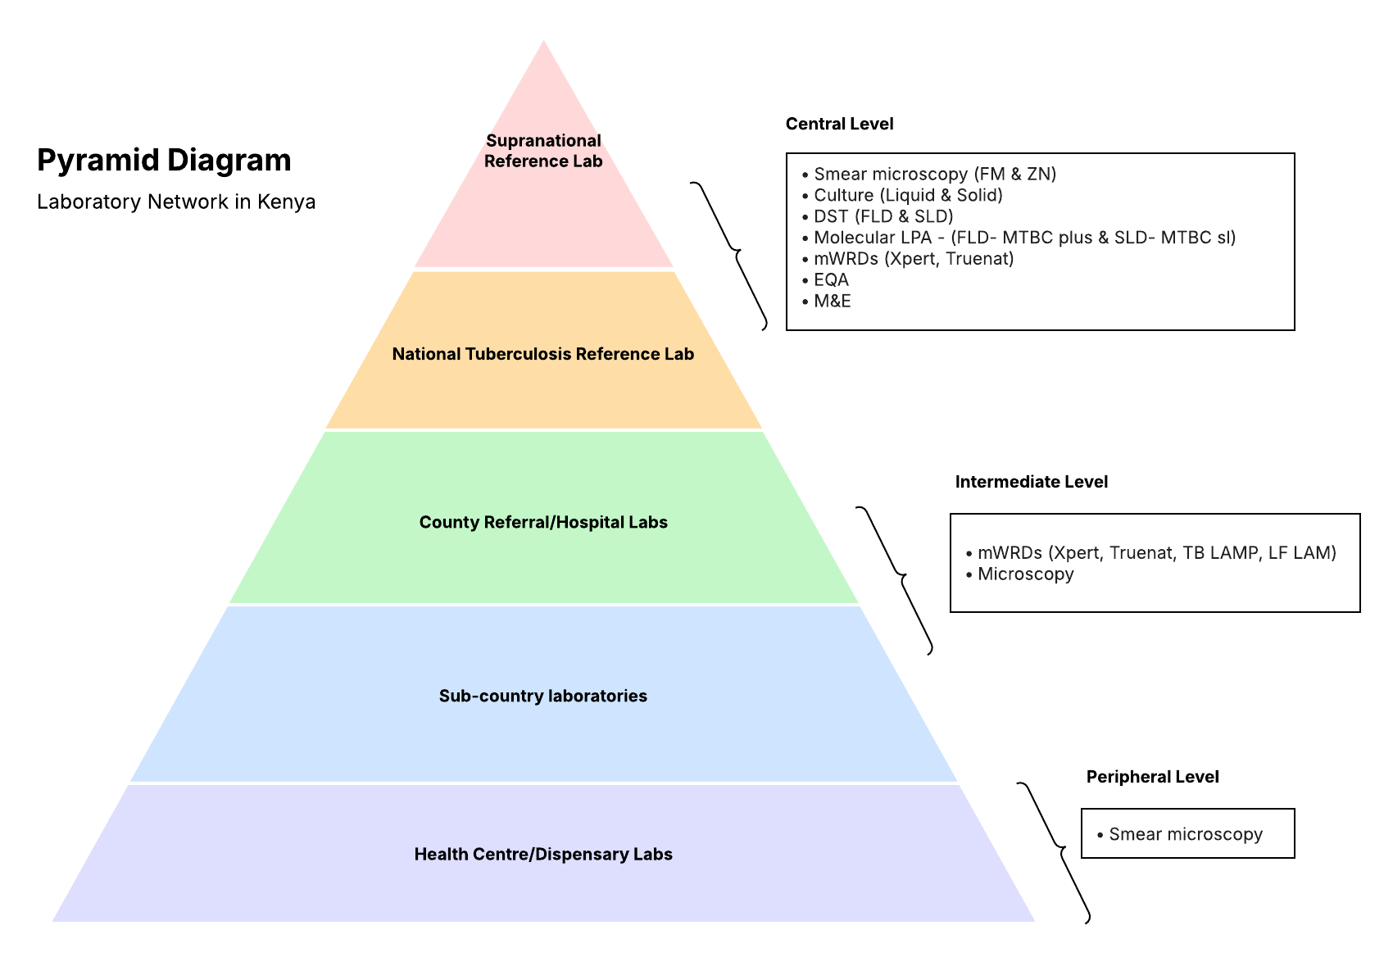
Country context: laboratory network
Notes:
Persistent TB Dx gap vs a diversified pipeline of new tests about to reach marketing stage.
3

Slide 4

Key findings
Regulatory processes
& uptake into national policy

Slide 5
Regulatory considerations (global /regional )
1. Reliance/ collaborative pathways
Recognized Regulatory Authorities | GHTF* (Classification rules) WHO PQ recommendation
Regional harmonization | East African Community Medicines Regulatory Harmonization (EAC-MRH) Regional Centres of Regulatory Excellence (RCORE) in pharmacovigilance
2. Continental mechanisms
African Medical Agency (AMA) ratification | Yes – ratification documents deposited 16th July 2023
Party to Africa Medical Device Forum (AMDF) -TCs | Yes [Chair – Paulyne Wairimu PPB]
Africa CDC Diagnostic advisory committee (DAC) member | Yes
* Global harmonization task force founding countries: Australia, Canada, EU, Japan, US

Slide 6
Regulatory requirements (national)
1.Regulatory stakeholders
NRA | PPB WHO GTB ML2*
2.Application for registration (public and private sectors)
Guiding documents | Pharmacy and Poisons Act (CAP 244) Guidelines on Reliance Mechanisms for Marketing Authorisation of Health Products and Technologies in Kenya (January 2025)
Online access to guidelines | Yes
Application portal | Yes
Language | English
Applicant | Local representative
License | Required
Expedited review pathways | Full evaluation Abridged evaluation Expedited evaluation
* WHO global benchmarking tool maturity level 2 indicative of a regulatory system that is evolving and partially functional, but not yet fully stable or integrated.

Slide 7
Regulatory requirements (national)
3.Registration approval timeline
Regular review | 6-12 months
Collaborative registration (EAC-MRH) | ~90–120 days (3–4 months) (Assessment timeline)
Expedited review | up to 7 months (received approval from two reference regulatory authorities)
Abridged review | up to 4 months (has obtained WHO PQ)
4.Marketing authorization validity
Initial | 5 years
Renewable ? | yes
5.Authorization of importation
Conformity assessment | Required, and must submit certificates, test reports, Declaration of Conformity ISO 13485
Other | Proof of pre-market approval or registration from an RRA
Temporary import mechanism | unclear

Slide 8
Uptake into national policy
5.Uptake in national policy
Local validation | Yes – Committee of Experts (CoE): This committee reviews the algorithms and tools for new diagnostics, engages end users, and ratifies the recommendations before they are approved at the TB health sector working group. Kenya Medical Research Institute (KEMRI)
Guiding documents | Guidelines on Reliance Mechanisms for Marketing Authorisation of Health Products and Technologies in Kenya (January 2025)
Key stakeholders | Ministry of Health (MoH) County Governments Committee of Experts (CoE) Donors and Implementing Partners Regulatory Agencies Medical Boards

Slide 9
Barriers/enablers for regulatory approval and adoption into policy
Regulatory approval & adoption into policy
Enablers | WHO PQ not required for regulatory approval, although is an enabler for expedited review. Completeness of documents submitted to PRIMS is an enabler for quicker processing. Established processes post-regulatory approval for inclusion of tests in national policy NTP already thinking about use of POC tests at primary care levels.
Barriers | Post-market surveillance is required. It can be resource intensive and may pose additional challenges for manufacturers. Capacity of PPB – have reported requiring more capacity building and skills on IVDs. WHO PQ required for adoption into national policy. Operational buy-in to involving lay testers
Notes:
CoE contribute as evidence generators for WHO GDG or TAG (i.e.: South Africa long track record in public sector/academia or Wits innovation Hub, Ethiopia/EPHI): “leap frogging” the in-country validation step

Slide 10
Key findings
Procurement and supply chain

Slide 11
Procurement and supply chain considerations
Procurement and Supply Chain
Guiding documents | Public Procurement and Asset Disposal Regulations 2020, Regulation 71 (head of the user department must submit a requisition to the head of the procurement function with supporting documentation, including feasibility studies)
Estimated timelines | Approval of the procurement application should take a maximum of 30 days from filing. The procurement process in total can take 6-9 months including the 30 days aforementioned. Steps include: 2-3 weeks for initial request and Treasury verification 2-3 weeks for quotation or tender process 1 month for contract negotiations and legal review 2 weeks for payment processing Additional time for pre-shipment documentation, tax exemption, and shipping. The entire process can stretch up to 9 months, depending on available resources, complexity of the contract, and coordination between different entities like KEMSA, Treasury, and manufacturers.

Slide 12
Procurement and supply chain considerations
Procurement and Supply Chain
Estimated volumes | Urine-LAM. There are approximately 1.4 million people on HIV care and treatment, with approximately 280,000 people (20%) likely requiring TB testing. For overall TB testing, Kenya aims to conduct 1.9 million tests annually, with a current breakdown of 60% for GeneXpert, 30% for TrueNAT, and 10% for LAM tests. Based on this, an initial volume of 28,000 test kits may be made. Swab-based molecular tests. 4-5 tests per day can be done across 900 facilities, however this would depend on availability of resource and patient sensitisation.

Slide 13
Barriers/enablers for procurement and supply chain
Procurement & supply chain
Enablers | Commitment of external funders to fund novel TB diagnostics in country would be an enabler for adoption. Relatively quick procurement processes.
Barriers | Length of procurement is dependent upon available resources, complexity of the contract, and coordination between different entities like KEMSA, Treasury, and manufacturers. Funding constraints due to geopolitical factors and shortages of external funding
Notes:
CoE contribute as evidence generators for WHO GDG or TAG (i.e.: South Africa long track record in public sector/academia or Wits innovation Hub, Ethiopia/EPHI): “leap frogging” the in-country validation step

Slide 14
Key findings
Use case(s) and implementation

Slide 15
Proposed use cases
Expected use case for next generation near point of care portable oral swab based rapid molecular tests and level of the health system appropriate for their deployment | Active case finding Symptomatic individuals at primary care network levels can undergo molecular swab testing. (Jeremiah Ogoro, NTP, 5th May 2025)
Expected use case for next generation LF LAM (irrespective of HIV status) and level of the health system appropriate for their deployment | Active case finding Urine LAM can be used at the primary care network levels during intensive active case finding. (Jeremiah Ogoro, NTP, 5th May 2025)

Slide 16
Considerations about implementation and scale up
Early adoption and roll out: health systems & implementation needs
Training required | Three types of training are necessary: Training of Trainers Training of technical users i.e. laboratory scientists, technicians, and technologists Training of lay testers i.e. community health promoters/workers
Network improvement/optimization and M&E
Enablers | Development of collaborations with manufacturers to develop sustainable in-country connectivity solutions. The country has experience with DNOs/DNAs being conducted every two years.
Barriers | Both the DNOs and connectivity solutions above were introduced by USAID-funded programmes. Given restrictions on USAID funding, it is currently unclear who will finance TB diagnostics DNOs and connectivity solutions.

Slide 17
Country CPA roadmaps

Slide 18
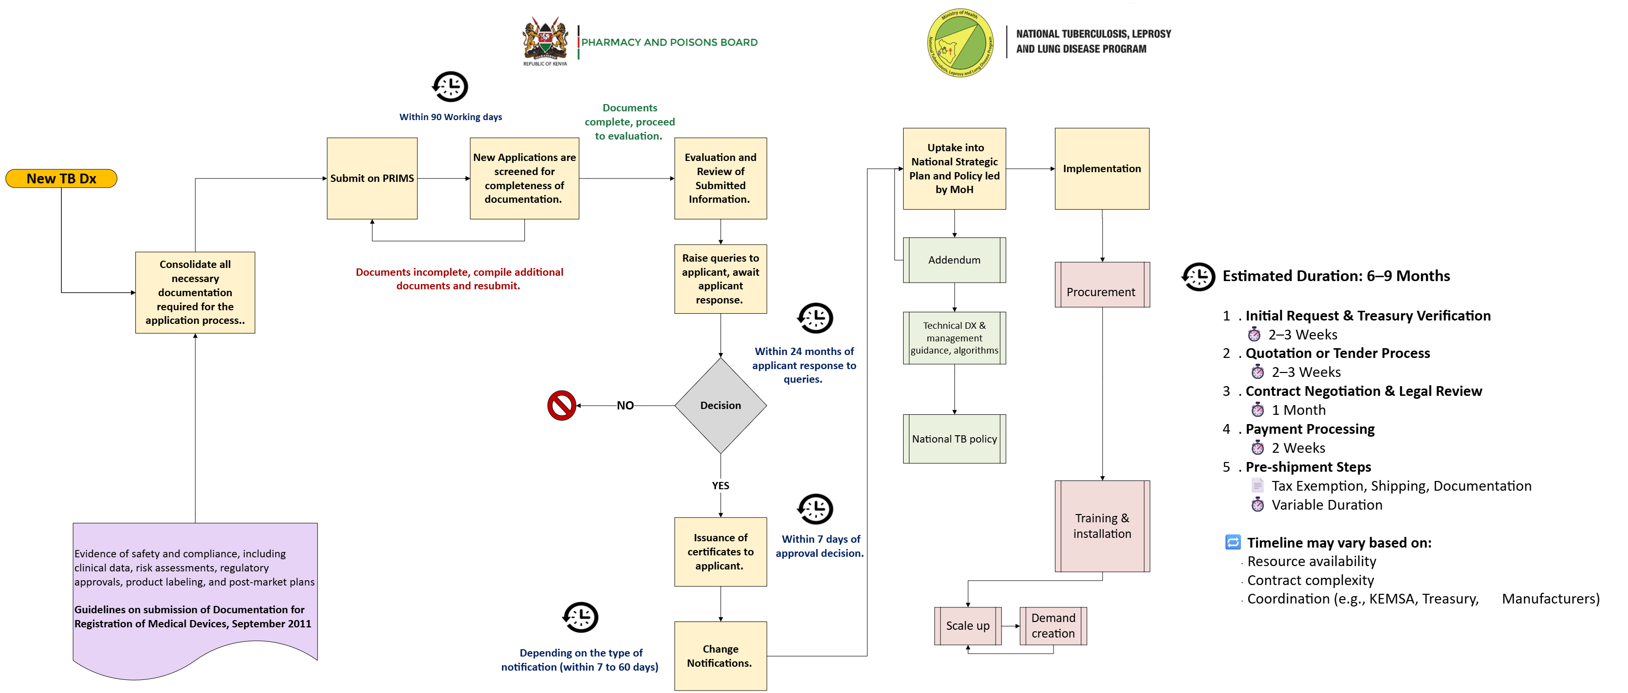
New TB diagnostic test introduction in the public and private sector

Slide 19
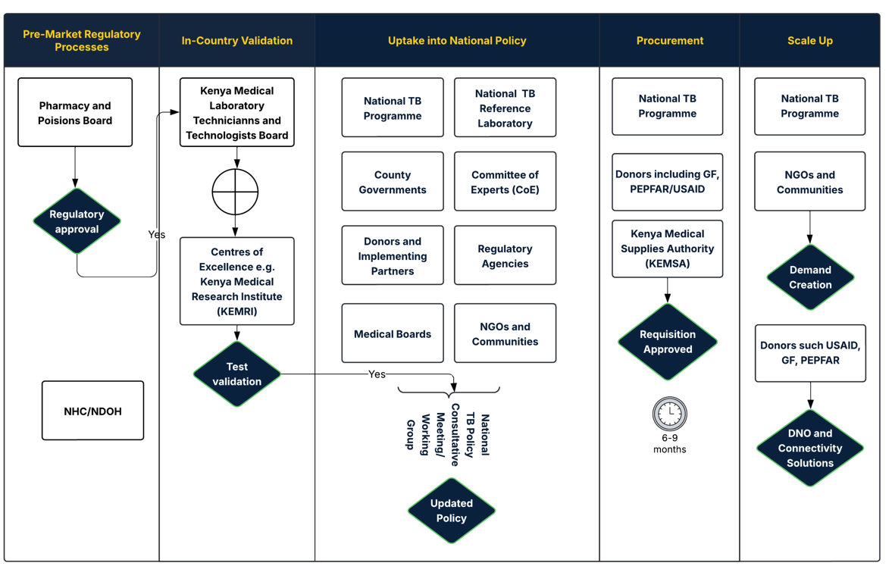
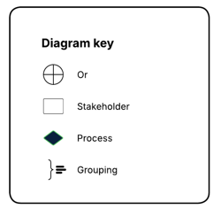
Stakeholder map

Slide 20
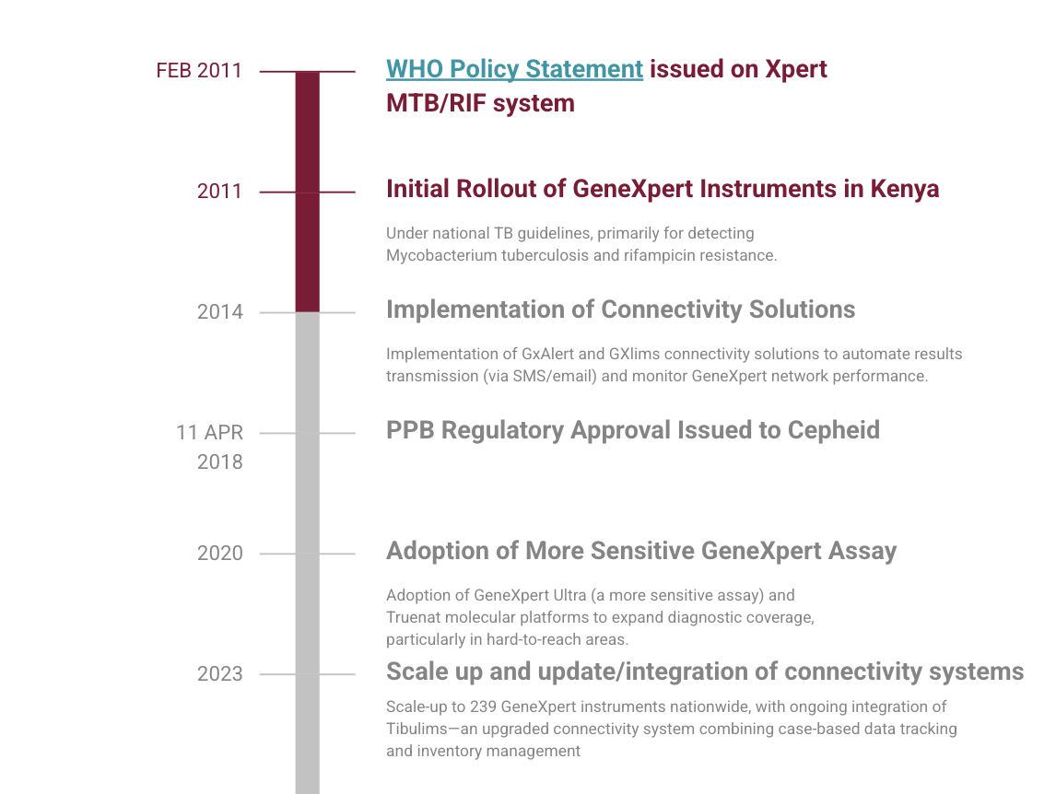
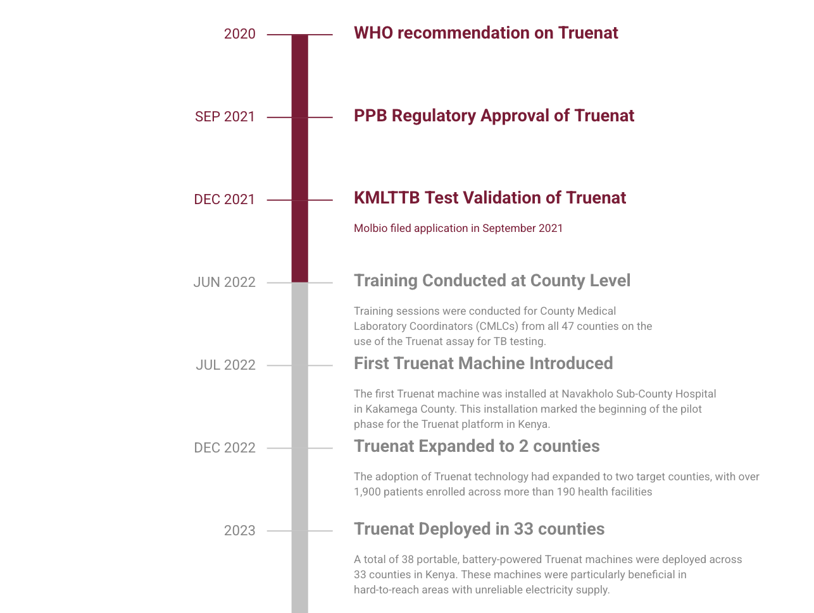
Historical pathway for GeneXpert and Truenat introduction

